Slide 1
MD5 Algorithm

Slide 2
MD5
MD5 is quite fast and produces 128 bit message digest
After some initial processing the input text is processed in 512 bit of blocks.
This 512 bit blocks are divided into 16, 32 bit sub blocks (16 x 32 = 512)
The output is set of 4 x 32 bit blocks = 128 bits message digest
Notes:
2

Slide 3
Working of MD5
Padding
Append length
Divide the input into 512 bit blocks
Initialize chaining variables
Process blocks

Slide 4
Step 1: Padding
The aim of this step is to make the length of the original message equal to a value which is 64 bit less than the exact multiple of 512
512 512-64 448
512 x 2 1024-64 960
512 x 3 1536-64 1472

Slide 5
Original Message
Padding (1-512 bits)
Original Message Padding
Total length should be 64 bit less than the exact multiple of 512
If 448 bits ( 448 = 512 – 64)
If 960 bits ( 960 = 2 x 512 -64)
If 1472 bits (1472 =3 x 512- 64)
Note: Padding is always added even if it is in terms of 512

Slide 6
Step 1 cont’d
If message length is 1000 add 472 = 1472
If message length is 448 add 512 = 960 , even though 448 is 64 bits less than multiple of 512
Reason
512 512-64 448
512 x 2 1024-64 960
512 x 3 1536-64 1472

Slide 7
Step 2: Append length
The length of the original message is Calculated and is appended to the end of the message block + padding

Slide 8
Original Message
Padding
length
Original Message Padding Length
64 bits
Data to be hashed
The length of the original message (excluding the padding) is calculated
It is appended to the end of the message block + Padding
The length is expressed in 64 bits
If the length of the message exceeds 2⁶⁴ bits of length then only last 64
bits are used. (by taking mod 64)
After 64 bit of length is appended this becomes the final message
This final message is to be hashed
The length of the message is in terms of 512 bits

Slide 9
Step 2 cont’d
If length of original message exceeds 2⁶⁴ then only last 64 bits of the length is used
After the 64 bits is added this becomes the final message
The length of the message is now in multiples of 512 bits

Slide 10
Step 3 Divide the i/p into 512 bits blocks
DATA TO BE HASHED
BLOCK 1
BLOCK 2
BLOCK N
512 bits
512 bits
512 bits

Slide 11
Step 4 – Initialize chaining variables
Four variables called as chaining variables are initialized
They are called as A B C and D
Each of these is a 32 bit no
The initial hex values are
A Hex 01 23 45 67
B Hex 89 AB CD EF
C Hex FE DC BA 98
D Hex 76 54 32 10

Slide 12
Step 5
After all the initializations the real algorithm begins
Its quiet complicated , we will discuss it step by step
There is a loop that runs for as many 512 bit blocks as are in the message

Slide 13
Step 5.1 : Process blocks
Copy the 4 chaining variables into 4 corresponding variables a ,b ,c, d
A -> a
B -> b
C -> c
D -> d
abcd
128 bit single register

Slide 14
Step 5.2 Divide
Divide the current 512 bit block into 16 sub blocks M [i]
Blk | 512 bits
SB1
SB2
SB16
32 bits
32 bits
32 bits

Slide 15
Step 5.3
There are 4 rounds.
In each round process all the 16 sub blocks
Inputs to each round are
All the 16 sub blocks
a, b, c, d
Some constants (t)

Slide 16
t
t is an array of constants
It contains 64 elements with each element consisting of 32 bits
t[1] , t[2] ……..t[64]

Slide 17
What is done in these four rounds?
All the four rounds vary in one major way
STEP 1 of the rounds has different processing
The other steps in all the four rounds are the same
In each round we have 16 input sub blocks names M[0] , M[1], …. M[15] each of 32 bits
We have t[k] , k varies form I to 64,
16 out of 64 values of t is used in each round

Slide 18
Iterations on all 4 rounds
After copying abcd we have 16 such iterations
Process P is performed on b,c,d . This process P is different in all the four rounds

Slide 19
Process P
A
B
C
D
PROCESS P
Process P: some basic Boolean operations on b,c,d
Round Process P
1 (b AND c) OR ((NOT b) AND (d))
2 (b AND d) OR (c AND (NOT d))
3 (b XOR c XOR d)
4 c XOR (b OR (NOT d))

Slide 20
The variable a is added to the output of process P
The message sub block M[i] is added to the output of step 2 i.e. to the register abcd
The constant t[k] is added to the output of step 3 i.e. to the register abcd
The output of step 4 is circular left shifted by s bits
The variable b is added to the output of step 5
The output of step 6 now becomes abcd for the next step

Slide 21
a
b
c
d
STEP 1
PROCESS P
STEP 2
ADD
M [i]
ADD
STEP 3
t [k]
ADD
STEP 4
SHIFT
STEP 5
STEP 6
ADD
STEP 7
a
b
c
d

Slide 22
Mathematically expressing MD5
a = b + (( a + process P(b,c,d) + M[i] + T[k] <<< s )
abcd – chaining variables
Process P – A non linear operation
M[i], t[i] – Sub blocks, constants
<<< s – Circular left shift by s bits

Slide 23
Strength of MD5
The possibility that 2 messages producing the same message digest using MD5 is in the order of 2⁶⁴
Given the message digest working backwards to find the message can lead up to 2 ¹²⁸ operations

Slide 24
Difference between MD4 and MD5
Number of rounds
Number of rounds in MD4: 3
Number of rounds in MD5: 4
Use of t
Same t values in MD4
Different t values for all iterations
Process P
Same in MD4
Different in MD5

Slide 25
Secure Hash Algorithm ( SHA )
Secure Hash Algorithm (SHA) was developed by NIST along with NSA.
In 1993, SHA was published as a Federal Information Processing Standard.
It has following versions-
SHA-0
SHA-1
SHA-2
SHA-3

Slide 26
SHA 1
Padding
Append Length
Divide input to 512 bit blocks
Initialize chaining variables
Process blocks

Slide 27
Initialize chaining variables
A- E
Therefore 5 x 32 = 160 bits as message digest
Same hex values form A-D
E – Hex C3 D2 E1 F0

Slide 28
SHA-1
It works for any input message that is less than 2⁶⁴ bits.
The output of SHA is a message digest of 160 bits in length.
This is designed to be computationally infeasible to:
Obtain the original message , given its message digest.
Find two messages producing the same message digest.

Slide 29
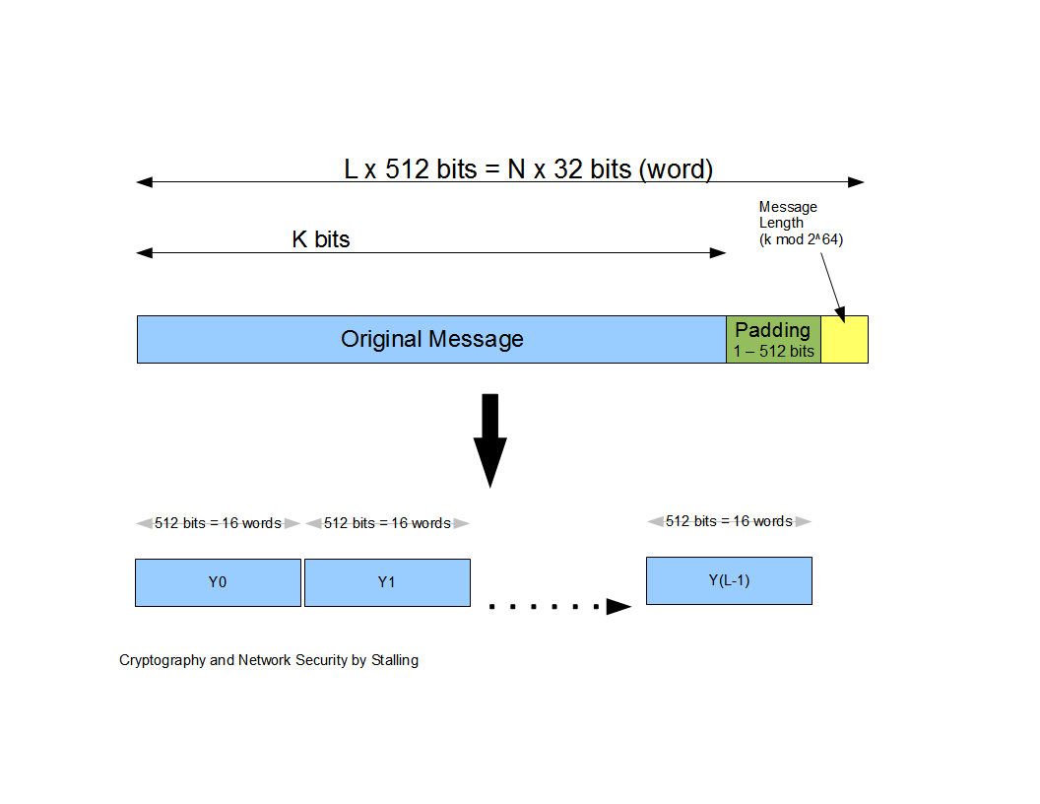
How SHA-1 works?
Step 1: Padding of Bits
Step 2: Append Length
Step 3: Divide the input into 512-bit blocks
1 | 0 | 1 | 1 | 0 | 1 | 0 | 0 | 0 | 0 | 0 | 0 | 0 | 0 | …………………………… | 0 | 0 | 0 | 0 | 1 | 1 | 0
Original string
Length of message
Padding of 0’s to 64 bits short of X 512
Total Message length multiple of 512

Slide 30
How SHA-1 works cont…
Step 4: Initialize chaining variables
Step 5: Process Blocks- Now the actual algorithm begins….
Chaining Variables | Hex values
A | 01 23 45 67
B | 89 AB CD EF
C | FE DC BA 98
D | 76 54 32 10
E | C3 D2 E1 F0

Slide 31
How SHA-1 works cont…
Step 5.1 : Copy chaining variables A-E into variables a-e.
Step 5.2 : Divide current 512-bit block into 16 sub-blocks of 32-bits.
Step 5.3 : SHA has 4 rounds, each consisting of 20 steps. Each round takes 3 inputs-
512-bit block,
The register abcde
A constant K[t] (where t= 0 to 79)
Round | Value of t between
1 | 1 and 19
2 | 20 and 39
3 | 40 and 59
4 | 60 and 79

Slide 32
How SHA-1 works cont…
Step 5.4 : SHA has a total of 80 iterations (4 rounds X 20 -iterations). Each iteration consists of following operations:-
abcde = ( e +Process P + S⁵(a) + W[t] + K[t] ), a, S³⁰(b) , c , d
Where,
abcde = The register made up of 5 variables a, b, c, d, e.
Process P = The logic operation.
S^{t} = Circular-left shift of 32-bit sub-block by t bits.
W[t[ = A 32-bit derived from the current 32-bit sub-block.
K[t] = One of the five additive constants.

Slide 33
How SHA-1 works cont…
Process P in each SHA round
Round | Process P
1 | (b AND c) OR (( NOT b) AND (d))
2 | b XOR c XOR d
3 | (b AND c ) OR (b AND d) OR (c AND d)
4 | b XOR c XOR d

Slide 34
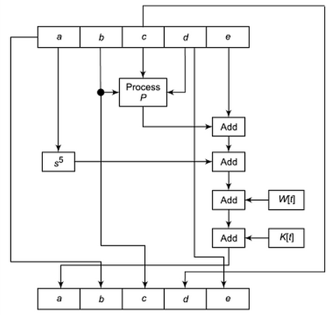
How SHA-1 works cont…
Single SHA-1 iteration

Slide 35
How SHA-1 works cont…
The values of W[t] are calculated as follows :
For the first 16 words of W (i.e. t=0 to 15) , the contents of the input message sub-block M[t] become the contents of W[t].
For the remaining 64 values of W are derived using the equation
W[t] = s¹ ( W[t-16] XOR W[t-14] XOR W[t-8] XOR W[t-3])

Slide 36
Comparison between MD5 and SHA-1
Point of discussion | MD5 | SHA-1
Message digest length in bits | 128 | 160
Attack to try and find the original message given a message digest | Requires 2¹²⁸ operations to break in. | Requires 2¹⁶⁰ operations to break in, therefore more secure.
Attack to try and find two messages producing same message digest | Requires 2⁶⁴ operations to break in. | Requires 2⁸⁰ operations to break in.
Speed | Faster | Slower
Successful attempts so far | There have been reported attempts to some extent. | No such claims so far.

Slide 37
Parameters for various versions of SHA
Parameter | SHA-1 | SHA-256 | SHA-384 | SHA-512
Message digest size(in bits) | 160 | 256 | 384 | 512
Message size(in bits) | <2⁶⁴ | 2⁶⁴ | 2¹²⁸ | 2¹²⁸
Block size (in bits) | 512 | 512 | 1024 | 1024
Word size (in bits) | 32 | 32 | 64 | 64
Steps in algorithm | 80 | 64 | 80 | 80

Slide 38
SHA-512
SHA-512 algorithm takes a message of length 2¹²⁸ bits and produces a message digest of size 512 bits.
SHA-512 was closely modeled after SHA-1 , which itself is modeled on MD5.

Slide 39
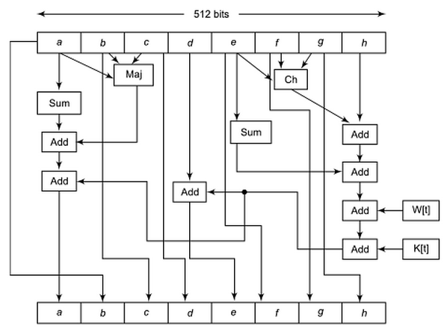
How SHA-512 works cont…
Single SHA-512 iteration

Slide 40
SHA
Developing Secure Hash Algorithm was initially major concern for defense authorities.
SHA produces message digest which has an application in digital signature.
In this way, this technique took a contributed in secure and robust encryption.

Slide 41
HMAC
Hash based Message authentication code

Slide 42
Message Authentication
message authentication is concerned with:
protecting the integrity of a message
validating identity of originator
non-repudiation of origin (dispute resolution)
three alternative functions used:
message encryption
message authentication code (MAC)
hash function
42

Slide 43
Broader Set of Attacks
disclosure
traffic analysis
masquerade
content modification
sequence modification
timing modification
source repudiation
destination repudiation
43

Slide 44
EXISTING SHA-1 OR MD5
ORIGINAL
MESSAGE
MESSAGE
DIGEST
ENCRYPT
MAC
K

Slide 45
MAC Properties
a MAC is a cryptographic checksum
MAC = C_{K}(M)
C is a function
condenses a variable-length message M
using a secret key K
many-to-one function
potentially many messages have same MAC
but finding these needs to be very difficult
45

Slide 46
Message Authentication Code (MAC)
a small fixed-sized block of data:
depends on both message and a secret key
like encryption though need not be reversible
appended to message as a signature
receiver performs same computation on message and checks it matches the MAC
provides assurance that message is unaltered and comes from sender
46

Slide 47
MAC
Concept of message authentication code is similar to message digest
Message digest is only finger print of the message
In contrast MAC requires that the sender and the receiver should know a shared symmetric secret key which is used in the preparation of MAC
That is MAC involving cryptographic processing

Slide 48
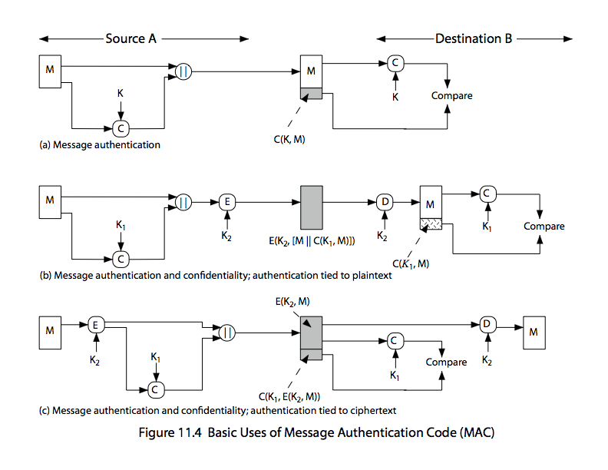
Message Authentication Code
48

Slide 49
Message Authentication Codes
MAC provides authentication
Message can be encrypted for secrecy
generally use separate keys for each
can compute MAC either before or after encryption
is generally regarded as better done before
why use a MAC?
sometimes only authentication is needed
sometimes need authentication to persist longer than the encryption (e.g., archival use)
note that a MAC is not a digital signature
49

Slide 50
Requirements for MACs
MAC needs to satisfy the following:
knowing a message and MAC, is infeasible to find another message with same MAC
MACs should be uniformly distributed
MAC should depend equally on all bits of the message
50

Slide 51
MAC
working
STEP 1
STEP 2
STEP 3
M
M
M
SENDER
A
MAC
SEND
RECEIVER
B
MAC
H1
H1
H2
STEP 4
COMPARE
K
K

Slide 52
HMAC
It’s a mandatory security implementation in IP security
Also used in SSL protocol
Reuses either SHA or MD5 message digest algorithms

Slide 53
EXISTING SHA-1 OR MD5
ORIGINAL
MESSAGE
MESSAGE
DIGEST
ENCRYPT
MAC
K

Slide 54
INPUTS
MD – The message digest/hash function used (MD5, SHA-1)
M – The i/p message whose MAC is to be calculated
L – The number of blocks in the message M
b - The number of bits in each block
K – The shared symmetric key used in HMAC
ipad - The string 00110110 repeated b/8 times
opad – The string 01011010 repeated b/8 times

Slide 55
Step 1 (Make K equal to b)
Generate the key K
If length (K) < b, expand k to make length equal to number of bits b in original message block (eg K= 170, b=512, add 342 bits all with 0 at the left of K)
If length (K) = b, no action
If length (K) > b, trim K to make the length of K equal to B. For this pass through any message digest algorithm, selected for this HMAC instance

Slide 56
Step 2
XOR K with ipad to produce S1

Slide 57
Step - 3
Append M to S1
S1
ORIGINAL MESSAGE M

Slide 58
Step - 4
Select MD5 or SHA-1 to output of step 3
Output of this operation is H

Slide 59
Step - 5
XOR K with opad to produce S2

Slide 60
Step - 6
Append H to S2
H is the message digest calculated
S2
H

Slide 61
Step - 7
Apply MD5 or SHA-1 to output of Step-6
This is the final MAC

Slide 62
Disadvantages
As symmetric key is used , exchange of keys is to be carefully carried out
Even if key is exchanged safely, HMAC cannot be used for more than one receiver
If more receivers are accepted then how would the receiver know who has sent it? Co receivers can send false message also

